Slide 2
Completing a Temporal Knowledge Base Graph on
Diachronic Entity Embedding and Applications
Supervisor: Dr. Nguyen Hong Thanh
Presentors: Le Ngoc Lam - Dao Duc Manh
Ha Noi, 22/10/2024

Slide 3
Overview
Introduction
Related Work
Methodology
Experiments
Conclusion

Slide 4
Introduction
Knowledge graphs store information about entities and their relationships. They are designed to help computers understand the meaning of data more easily by organizing it in a structured, meaningful way that can be queried and analyzed effortlessly.
Temporal Knowledge Graph Completion (TKGC) is an extension of knowledge graph completion that incorporates time as a factor.
This present addresses the challenge of completing knowledge graphs by focusing on temporal knowledge graph completion methods, which account for changes in data over time

Slide 5
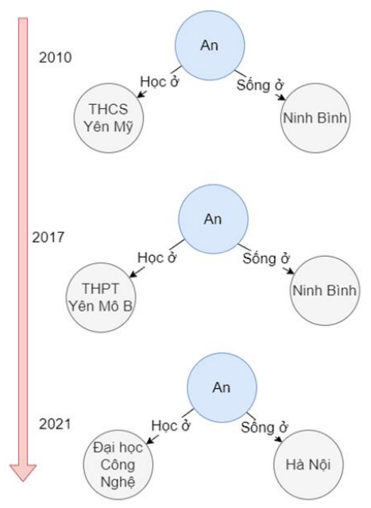
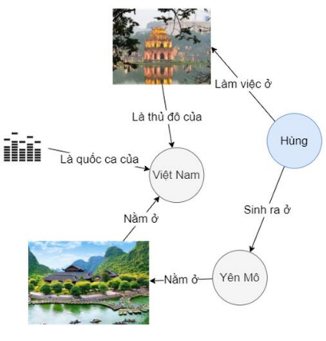
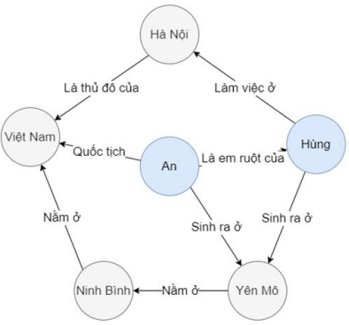
2. Related Work
Knowledge Graph(KG): structured representation of knowledge, consists of nodes (entities) and edges (relationships) that connect them
Static KG
Temporal KG
Multi-model KG

Slide 6
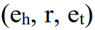
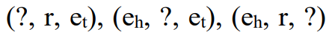
2. Related Work
Static Knowledge Graph Completion
Given to query relationship/entities
There are 3 types of method:
Embedding-based: learn low-dimensional vector representations for entities and relations, predicting missing links by ranking k-triples.
Path-based: analyze paths between entities
Rule-based: predict missing relationships by applying predefined or learned logical rules

Slide 7
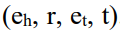
2. Related Work
Temporal Knowledge Graph Completion
Given to query relationship/entities/time
There are 2 types of method:
RNN-based: use RNNs like LSTM/GRU to capture sequential patterns
RNN-agnostic: extend static knowledge graph methods to temporal graphs

Slide 8
3. Methodology
3.1 SimplE
3.2 Diachronic Embedding
3.3 DE-SimplE, MDE-RotatE
3.4 MDE-SimplE-GCN

Slide 9
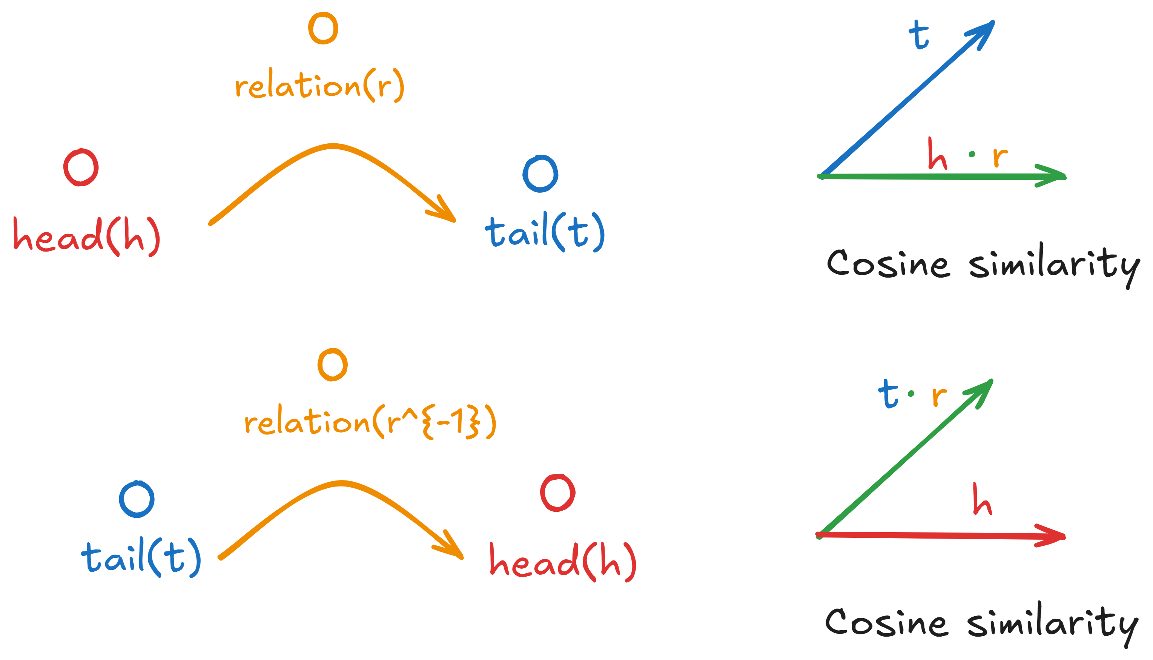
3.1 SimplE
SimplE (Simplified Embedding) is an embedding learning method for representations in knowledge graphs.

Slide 10
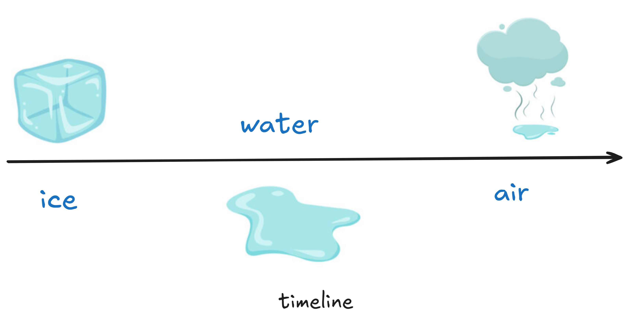
3.2 Diachronic Embedding
Name of object change due to the timeline
=> How to utilize it for entity representation?
=> Dynamic Embedding

Slide 11
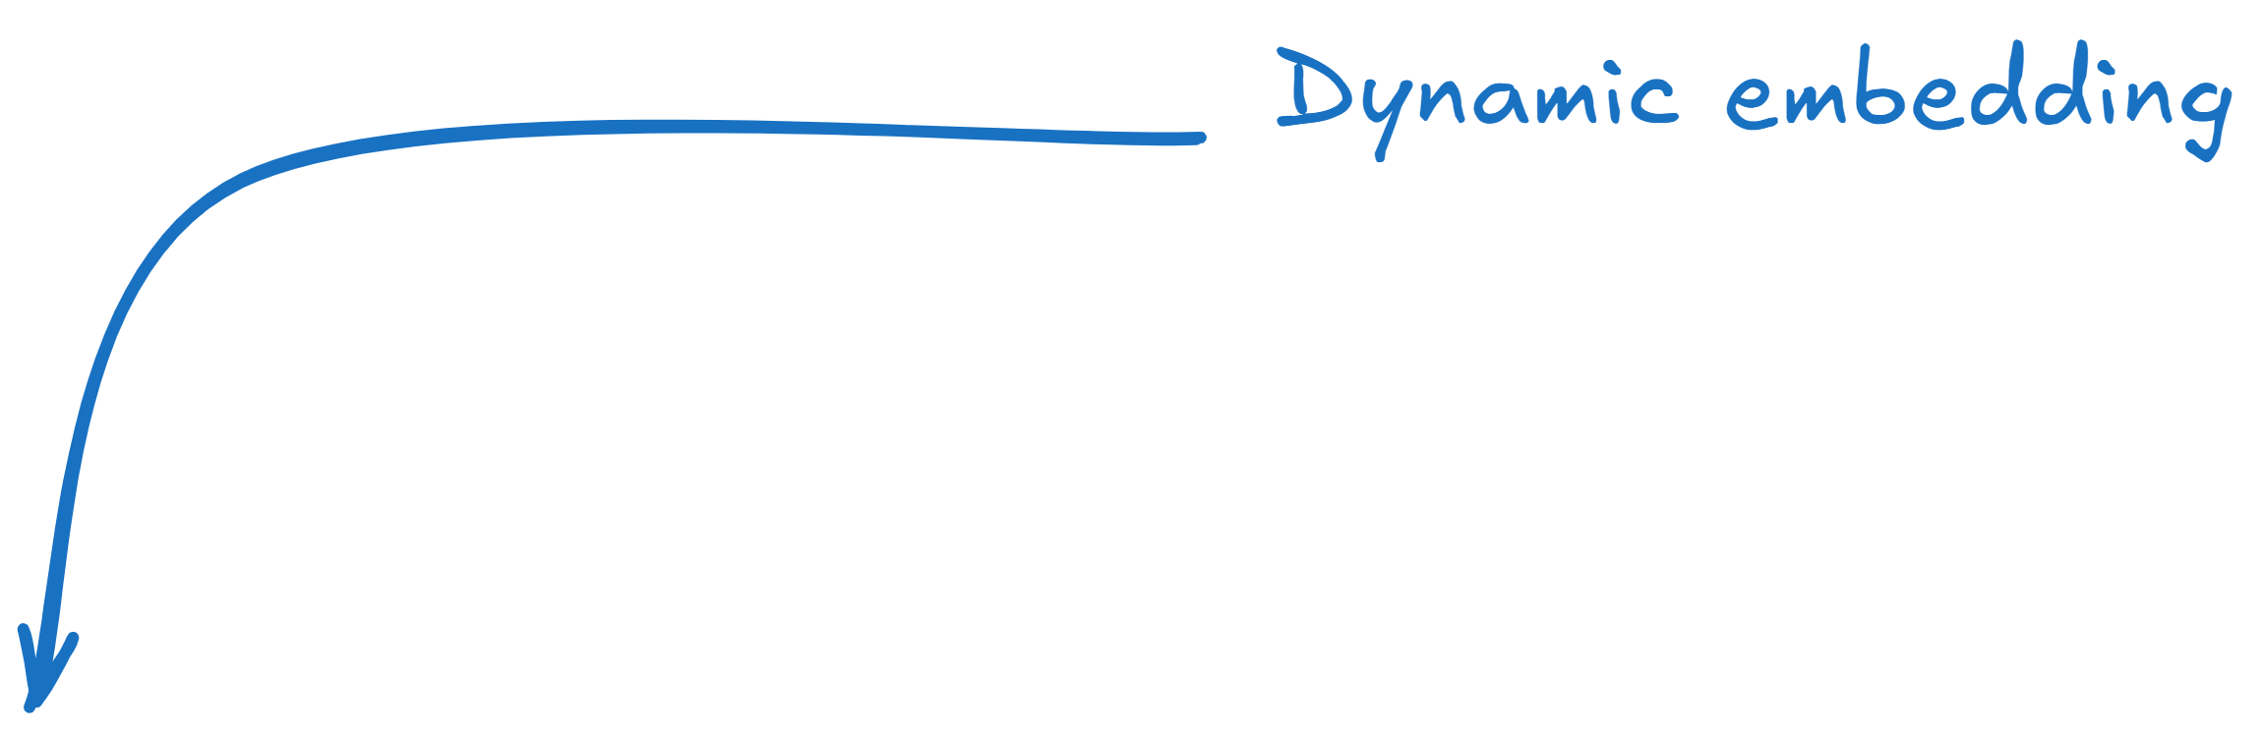
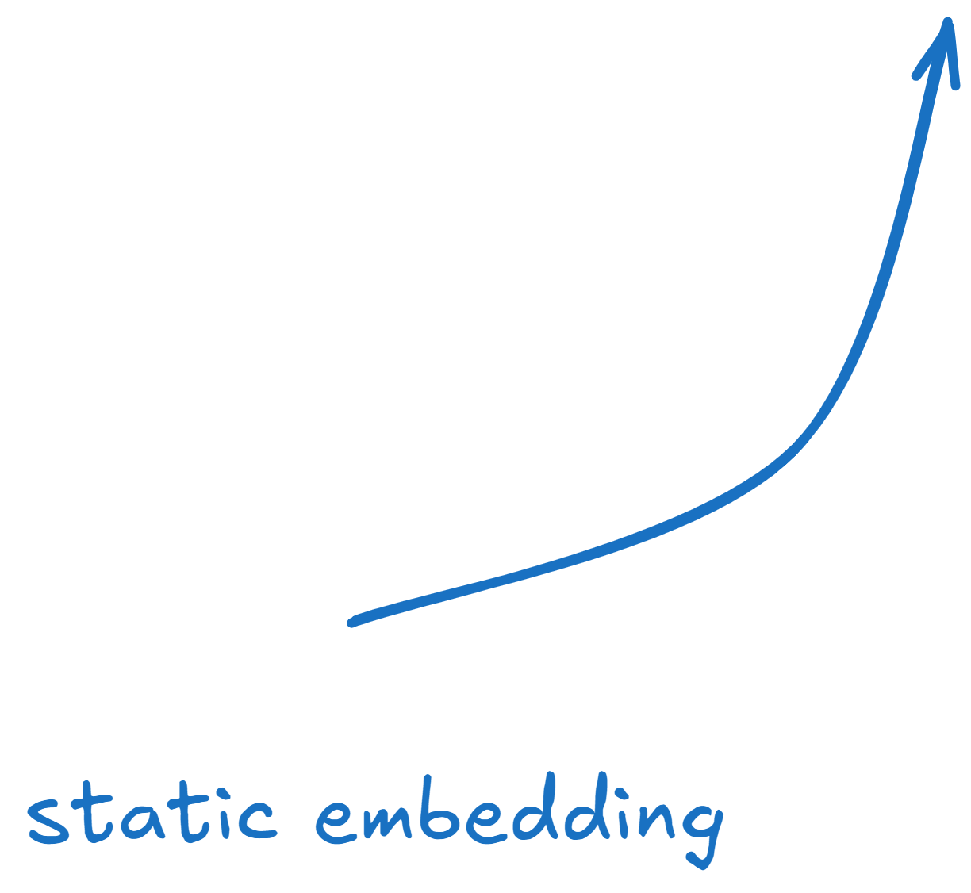
3.2 Diachronic Embedding - Formulation

Slide 12
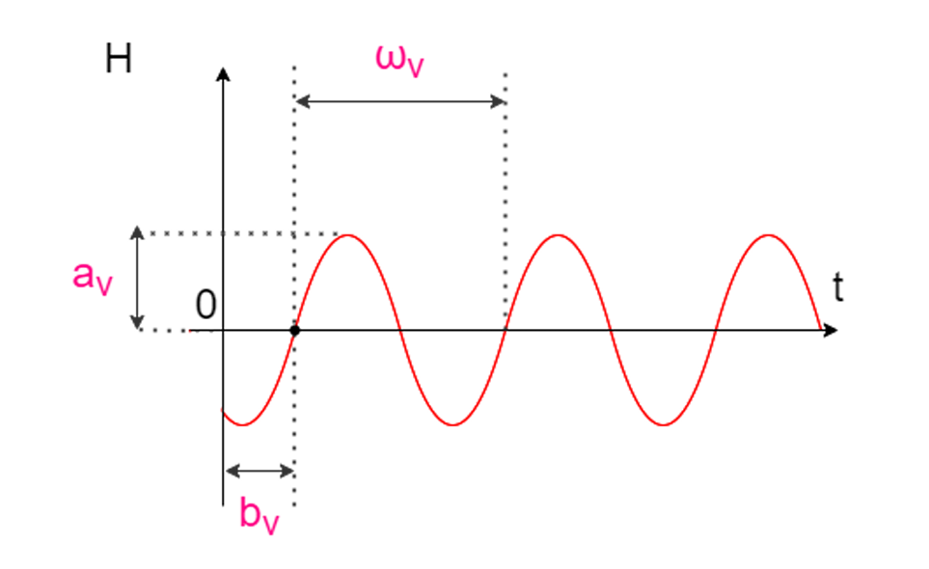
3.2 Diachronic embedding – Dynamic Part

Slide 13
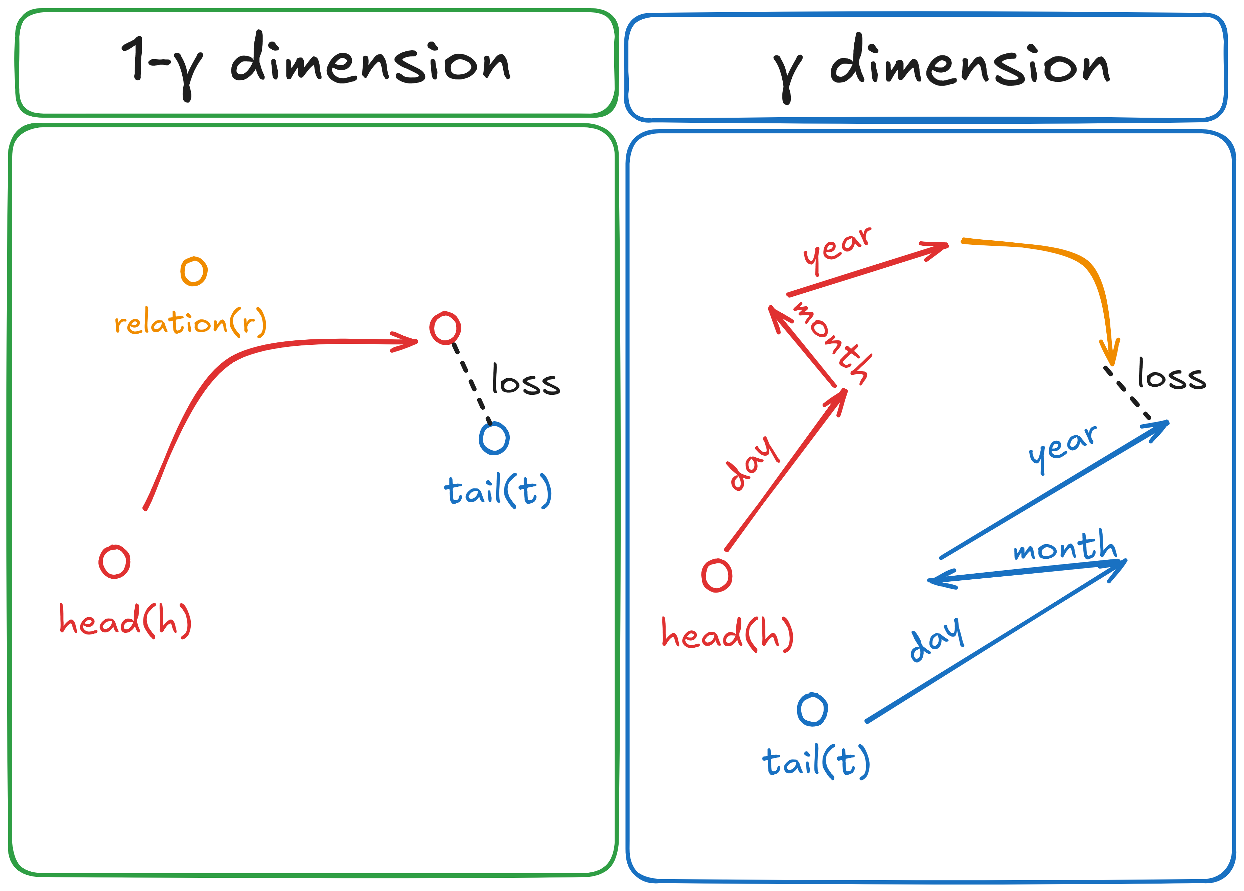
3.2 Diachronic embedding – Time variant
In the case time is defined by Day – Month – Year

Slide 14
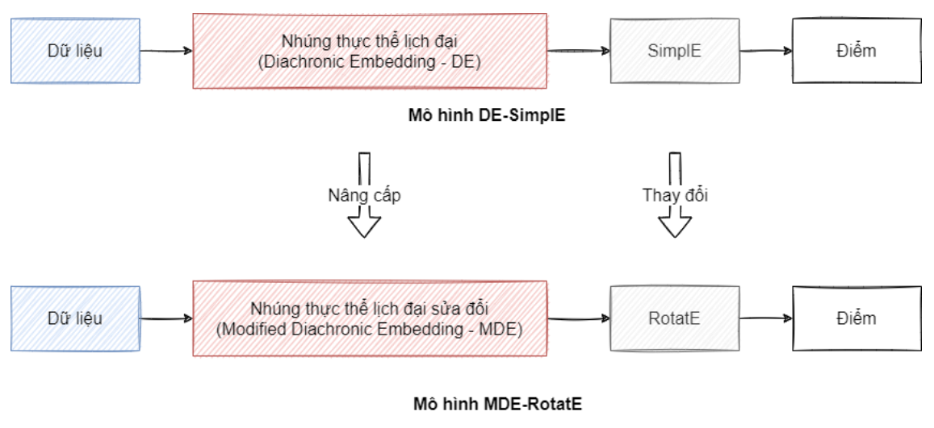
3.3 DE-SimplE, MDE-RotatE
Modified Diachronic Embedding - RotatE

Slide 15
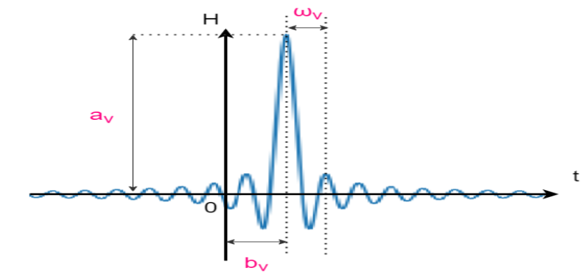
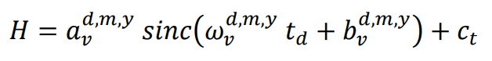
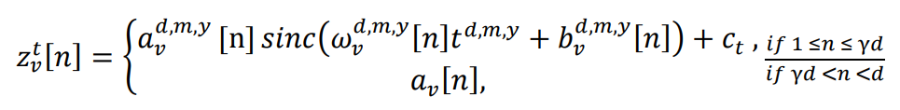

3.3 DE-SimplE, MDE-RotatE
DE insights:
Sine function is good enough?
Periodic, symmetric
Not all the cases
Sinc function
Asymmetric, convergence at center
Good at the cases 1 entity – value
Function H needs at least 2 timestemps for same value?
Large Entity – Long Timestempt

Slide 16
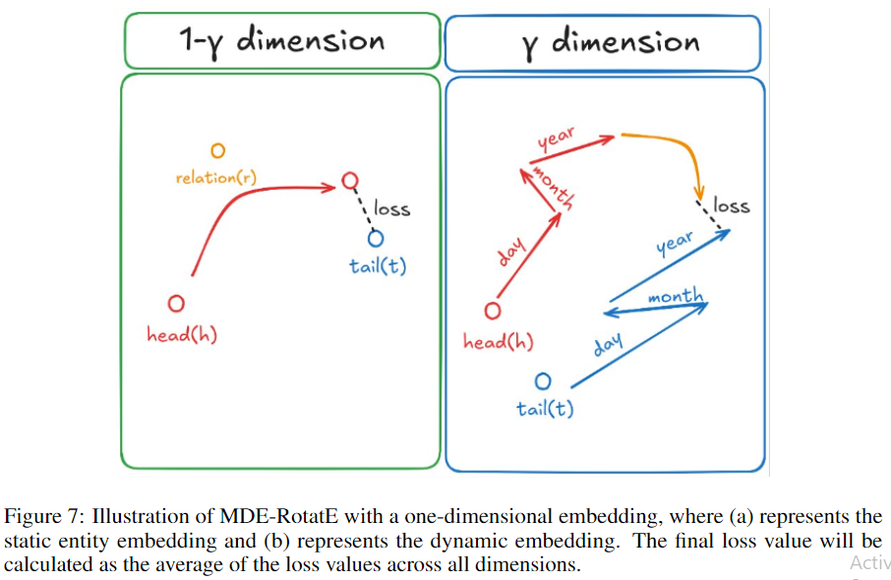
3.3 DE-SimplE, MDE-RotatE
Selecting Static KG Completion

Slide 17
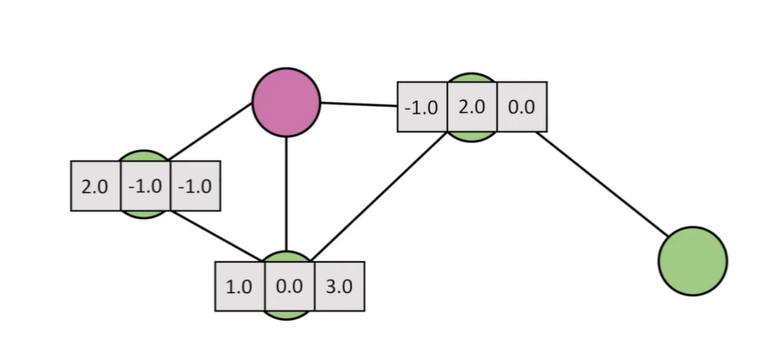
3.4 Diachronic with Embedding SimplE and Graph Convolution Network
What is Graph Convolution Network ?

Slide 18
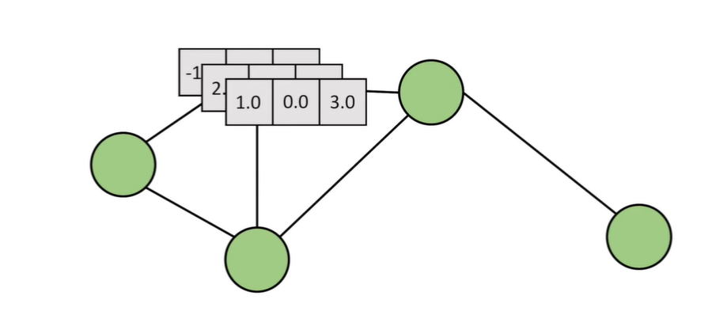
3.4 Diachronic with Embedding SimplE and Graph Convolution Network

Slide 19
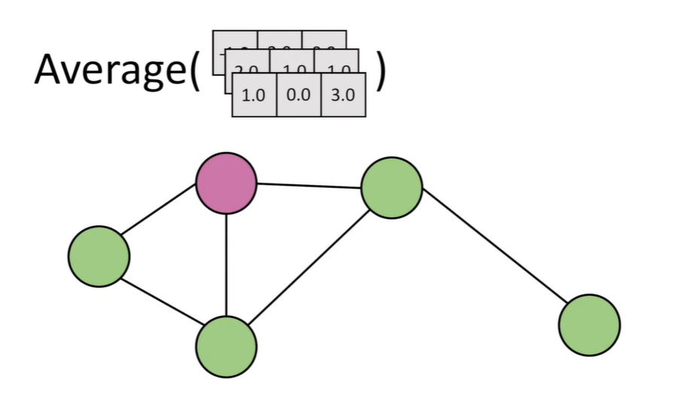
3.4 Diachronic with Embedding SimplE and Graph Convolution Network

Slide 20
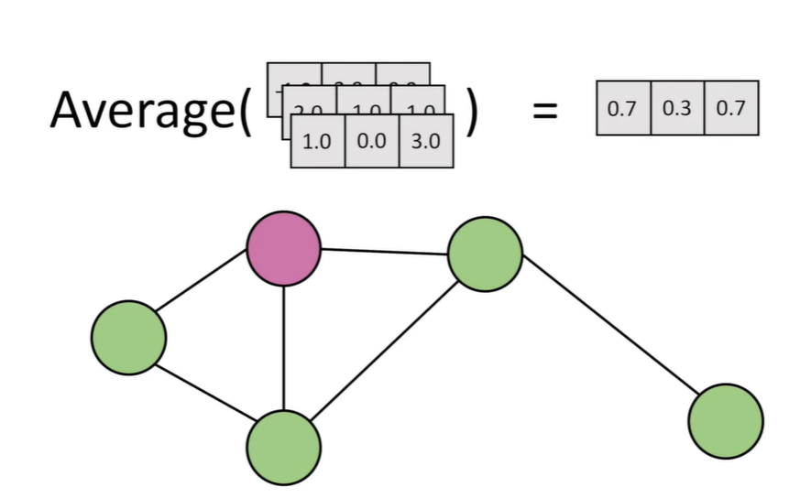
3.4 Diachronic with Embedding SimplE and Graph Convolution Network

Slide 21
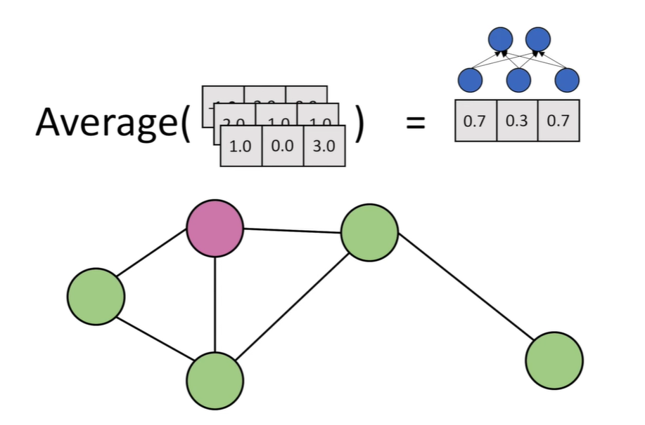
3.4 Diachronic with Embedding SimplE and Graph Convolution Network

Slide 22
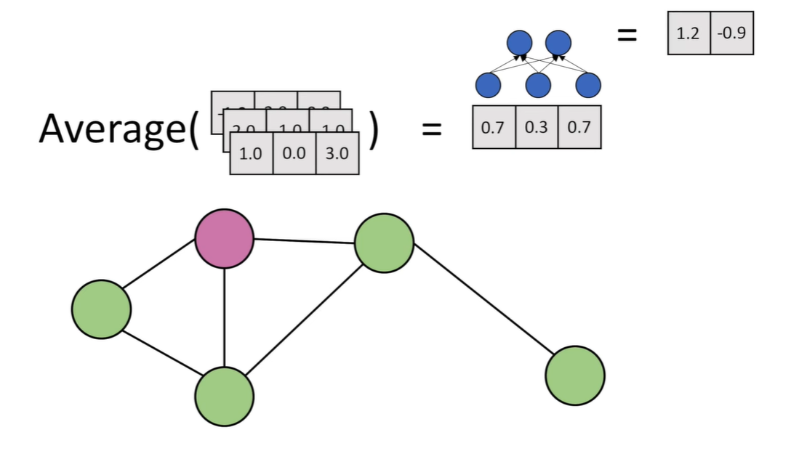
3.3 Diachronic with Embedding SimplE and Graph Convolution Network

Slide 23
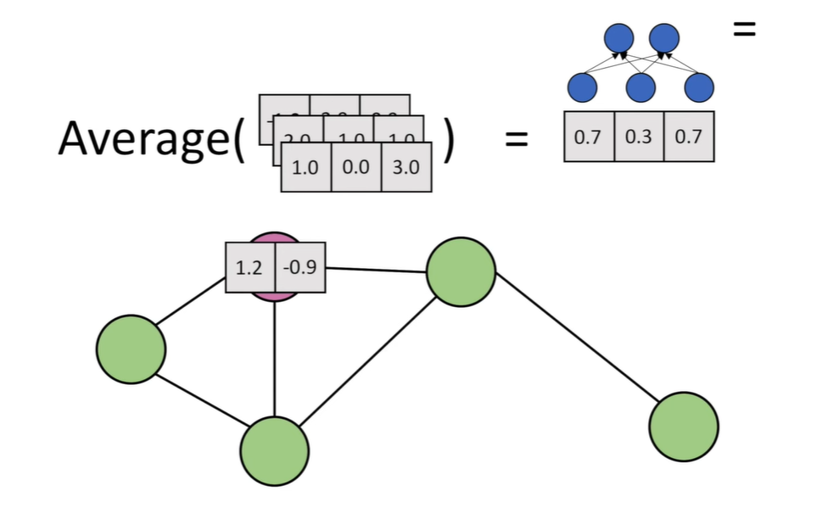
3.4 Diachronic with Embedding SimplE and Graph Convolution Network

Slide 24
3.4 Diachronic with Embedding SimplE and Graph Convolution Network

Slide 25
4. Experiment
4.1 Measure
4.2 Data
4.3 Result

Slide 26
4.1 Measure

Slide 27
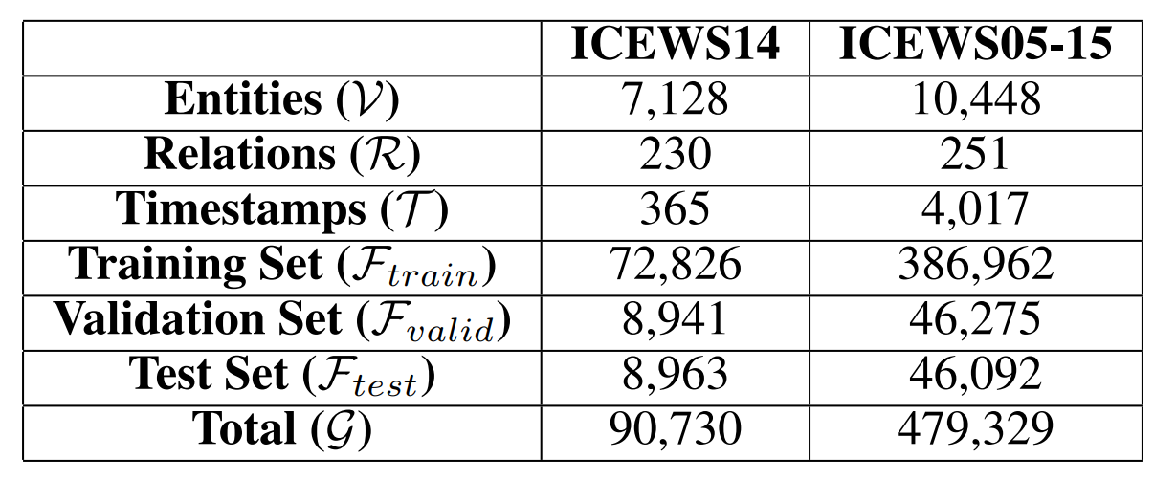
4.2 Data
Data of Knowledge Graph:
ICEWS14 includes events in 2014
ICEWS05-15 includes events from 2005 to 2015
Table 1 Data of Knowledge Graph

Slide 28
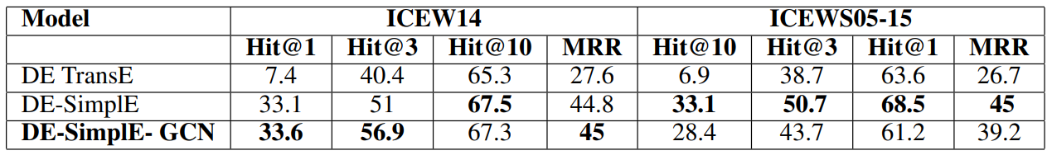
4.3 Result - GCN
TransE: simple transition -> not well format data space, too large graph
SimplE: better once with results has been proved
GCN: extract further structure architecture
Table 2 Compare result of DE-SimplE-GCN with other model

Slide 29
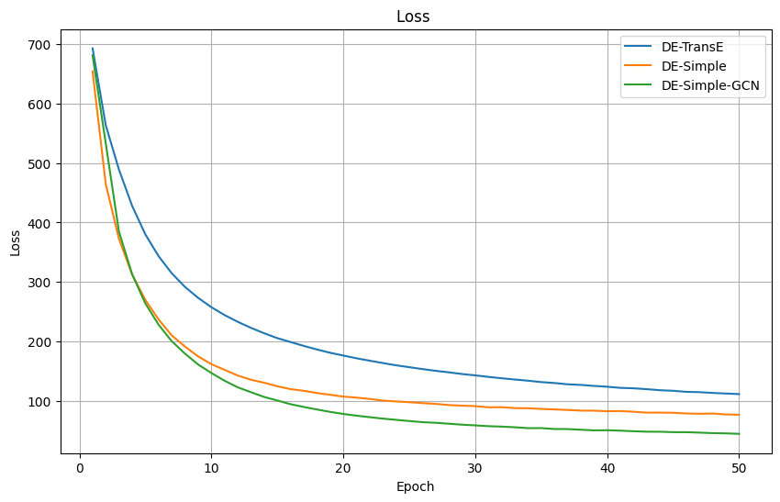
4.3 Result
Figure 1: Compare loss of DE-TransE, DE-Simple,DE-Simple-GCN

Slide 30
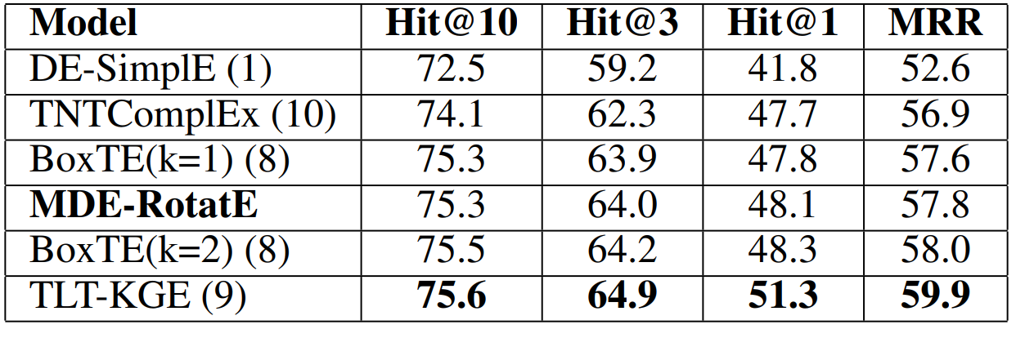
4.3 Result – Latest Architecture
Table 3: Comparison of the proposed model with the latest models on the ICEWS14 dataset with marginal parameters

Slide 31
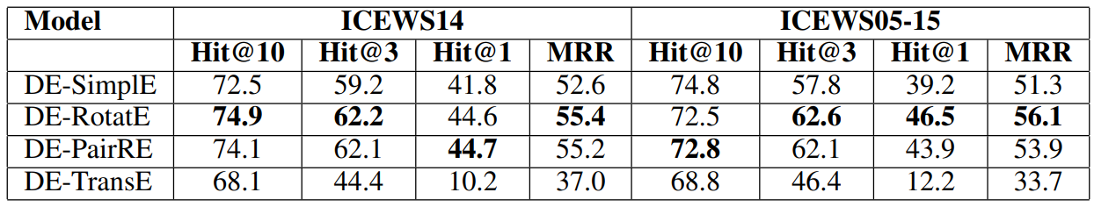
4.3 Result – Different Static KG
Table 4: Comparison of the experimental results combining diachronic embeddings with several static knowledge graphs

Slide 32
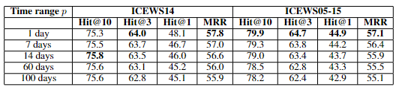
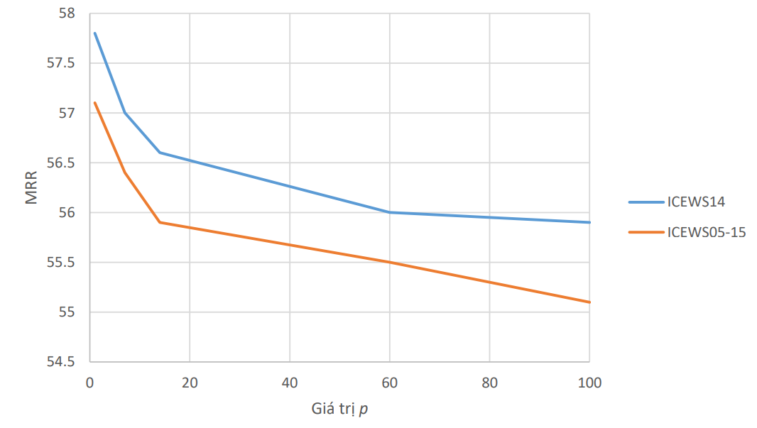
4.3 Result – Different Static KG
Table 5: Different value of time embedding
Shorter Timestampt Embedding, Better Results

Slide 33
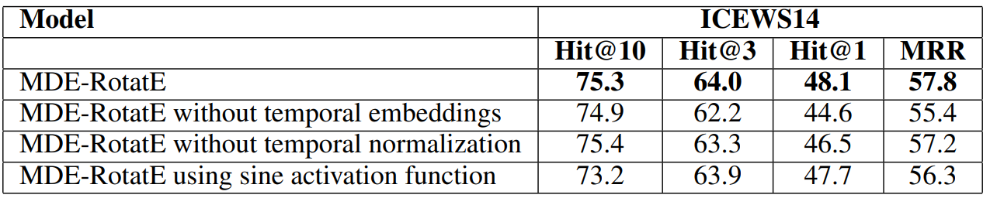
4.3 Result – Ablation Study
Table 5: Comparison of experimental results when omitting the proposed improvements

Slide 34
5. Coclusion
Propose the Modified Diachronic Embedding-SimplE with Graph Convolution model for completing temporal knowledge graphs. Experiments in ICEWS14 proposed improvements that enhance performance compared to the original DE-SimplE model.
Modified Diachronic Embedding-RotatE (MDE-RotatE) model for complet-ing temporal knowledge graphs. The model combines a new diachronic entity embedding method, which is an improvement upon the method by R. Goel et al. (2022) with the static knowledge graph completion model RotatE.
Experiments on two datasets, ICEWS14 and ICEWS05-15, show that the MDE-RotatE model has achieved good results .Specifically, the model achieved the best results with75.3, 64.0, 48.1, and 57.8 corresponding to Hits@10, Hits@3, Hits@1, and MRR, which is 9.9%higher than the original model on the ICEWS14 dataset.

Slide 35
THANKS FOR ATTENTION

